Slide 1

Predicting And Analyzing Urban Water Quality Using Machine Learning
TEAM DETAILS : CSE_056(THE NETIZENS)
UFAIRA TAZHEEN(18UK1A05B4)
MUZAFFAR HUSSAIN KHAN(18UK1A0590)
MD.ADEEB FARHAN(18UK1A0586)
MD.MAQSOOD ALI(18UK1A0587)

Slide 2
CONTEXT :
INTRODUCTION
OBJECTIVE
DATA
MACHINE LEARNING APPROACHES
VISUALIZATION OF GRAPHS
SOFTWARE REQUIREMENTS
CONCLUSION

Slide 3

INTRODUCTION
Water is considered as a vital resource that affects various aspects of human health and lives. The quality of water is a major concern for people living in urban areas. Quality of water serves as a powerful environmental determinant and a foundation for the prevention and control of waterborne diseases. However predicting the urban water quality is a challenging task since the water quality varies in urban spaces non-linearly and depends on multiple factors, such as meteorology, water usage patterns, and land uses, so this project aims at building a Machine Learning (ML) model by considering all water quality standard indicators.

Slide 4
OBJECTIVE
Often Water Resources Management objectives include promoting conditions for environmentally sustainable, economically efficient and equitably allocated use of water resources.
They also include to increase the benefits and reduce the risk related to existing hydraulic infrastructure.
The main objective is to explore what kind of data is provided, determine the most important to factors to check whether the water is portable or not, and select the most accurate model to suitable for prediction.

Slide 5
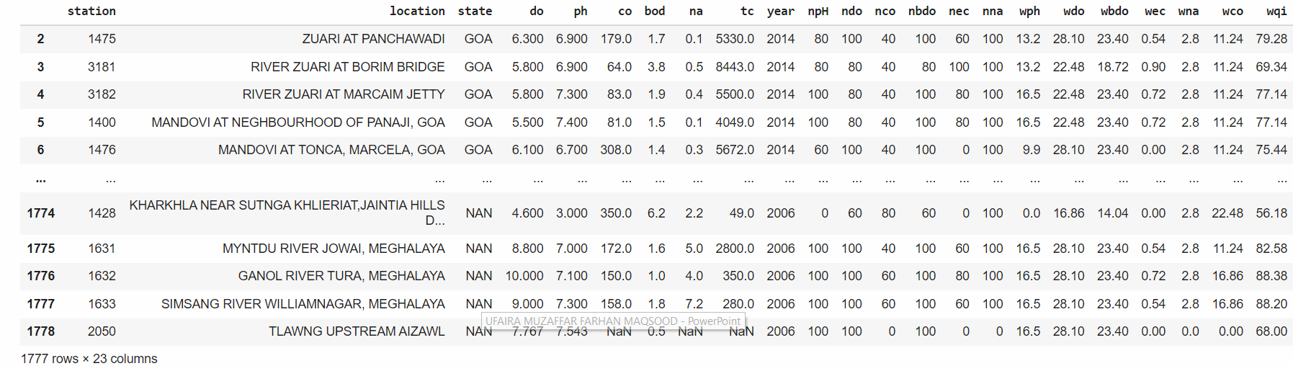
DATA
The data sets consists of:
1992 rows and 12 columns
STATION CODE
LOCATIONS
STATE
TEMPERATURE
DISSOLVED OXYGEN (mg/L)
PH
CONDUCTIVITY (μmhos/cm)
BIOLOGICAL OXYGEN DEMAND(mg/L)
NITRATENAN N+ NITRITENANN (mg/L)
FECAL COLIFORM (MPN/100ml)
TOTAL COLIFORM (MPN/100ml)
YEAR
Data Source : Internet

Slide 6
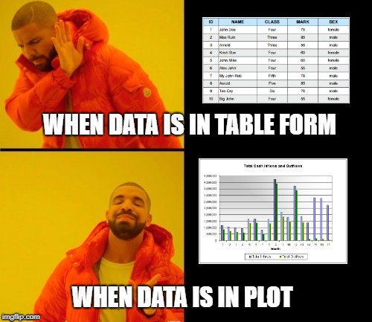
DATA VISUALISATION
Data Visualization is an increasingly central activity in the field of Analytics. We often talk about Data Design, that is, a structured approach to creating visual and interactive reports that allow those who observe them to easily interpret them and quickly grasp the most significant information.
Analyzing the data collected by your ERP or your CRM observing the visual representation allows you to:
· understand them faster and more thoroughly
· make better predictions
· share your analyzes more easily
· guide the decision-making process
· discover new points of view

Slide 7
MODEL BUILDING:
There are several Machine learning algorithms to be used depending on the data you are going to process such as images, sound, text, and numerical values. The algorithms that you can choose according to the objective that you might have it may be Classification algorithms are Regression algorithms.
Example:
1.Linear Regression
2.Logistic Regression
3. Random Forest Regression / Classification.
4. Decision Tree Regression / Classification.
You will need to train the datasets to run smoothly and see an incremental improvement in the prediction rate.
On our Dataset , we have applied Random Forest to predict the Accuracy.

Slide 8
MACHINE LEARNING ALGORITHMS:
Random Forest :
A random forest is a machine learning technique that’s used to solve regression and classification problems. It utilizes ensemble learning, which is a technique that combines many classifiers to provide solutions to complex problems.
Working of Random Forest Algorithm
First, start with the selection of random samples from a given dataset.
Next, this algorithm will construct a decision tree for every sample. Then it will get the prediction result...
In this step, voting will be performed for every predicted result.
At last, select the most voted prediction result as the final prediction result.

Slide 9
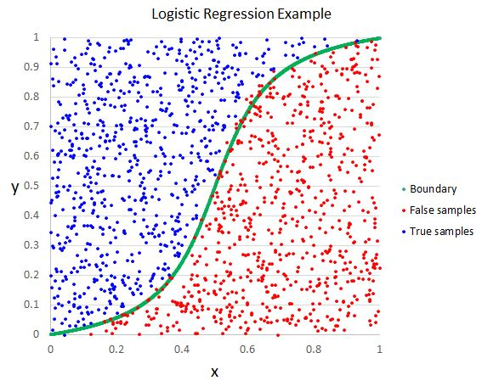
LOGISTIC REGRESSION:
Logistic regression is a supervised learning classification algorithm used to predict the probability of a target variable. The nature of target or dependent variable is dichotomous, which means there would be only two possible classes. ... Mathematically, a logistic regression model predicts P(Y=1) as a function of X.
Logistic Regression is used when the dependent variable (target) is categorical. For example,
To predict whether an email is a spam (1) or (0)
Whether the tumor is malignant (1) or not (0)
Out of all the algorithms Logistic Regression got the highest accuracy .
So, We build a model with Logistic regression.

Slide 10
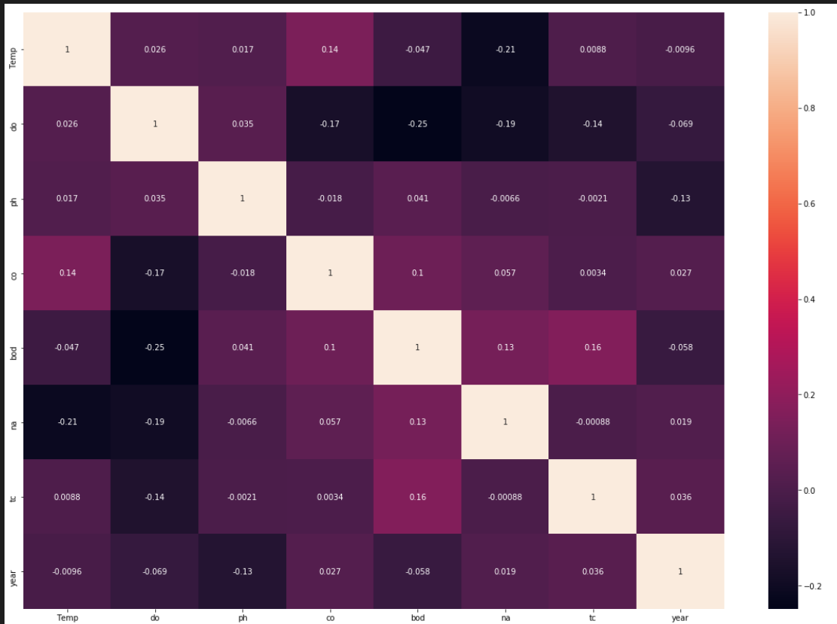
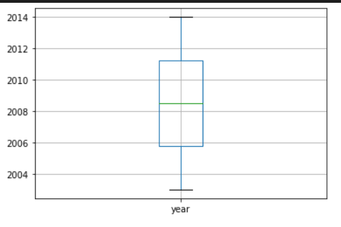
VISUALISATION OF GRAPHS

Slide 11
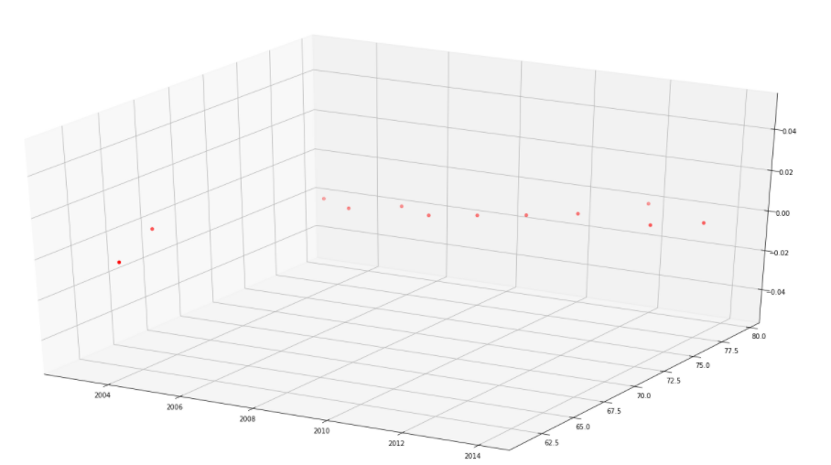
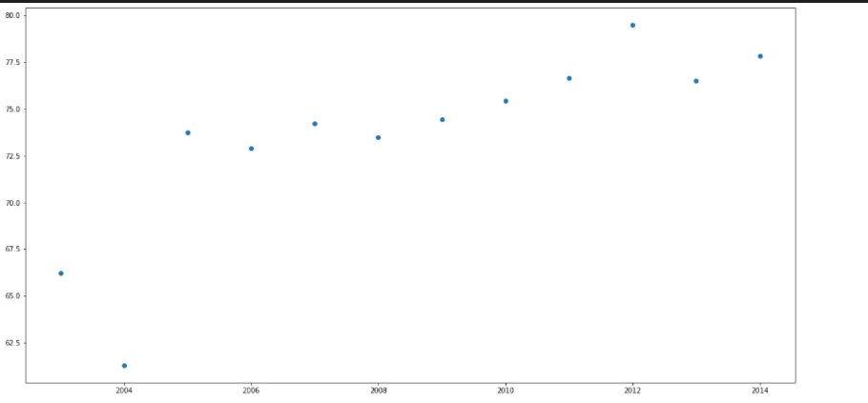

Slide 12
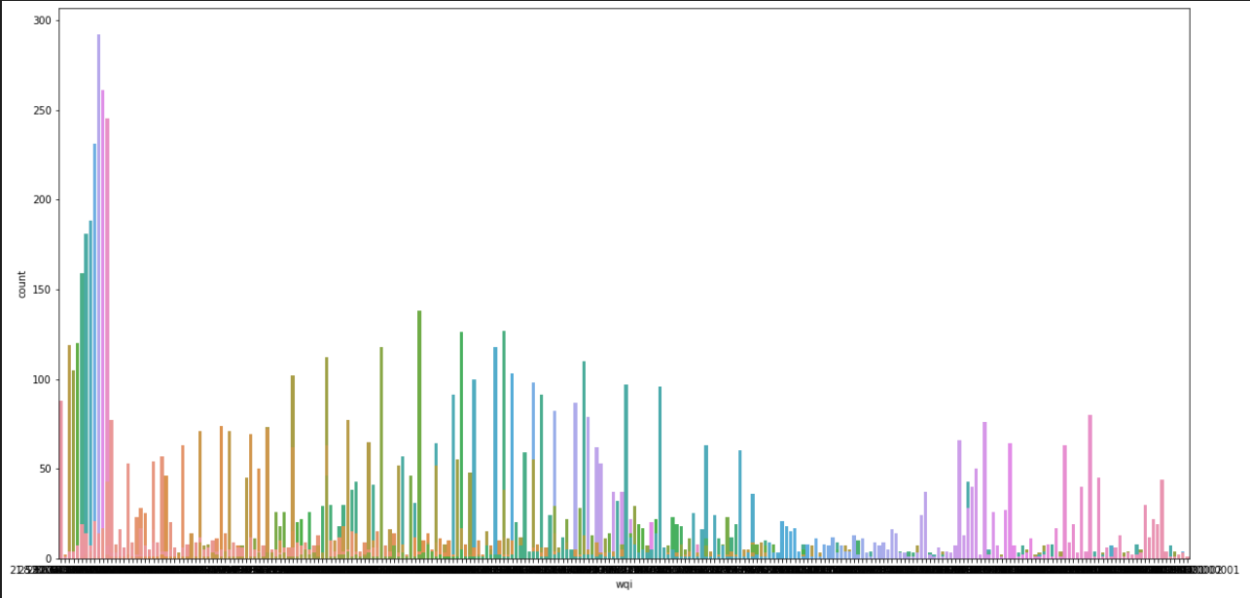
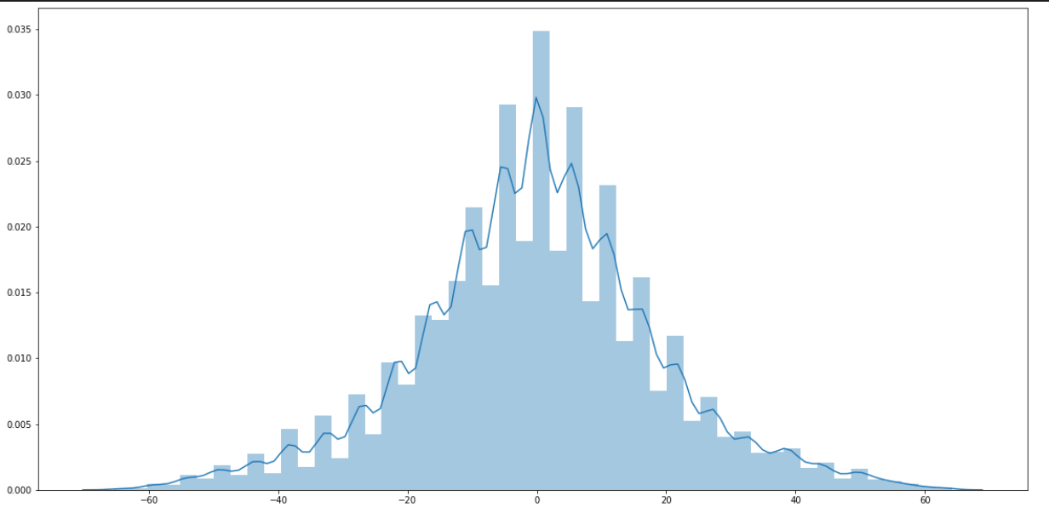

Slide 13
SOFTWARE REQUIREMENTS:
Google colab
Anaconda navigator
Jupyter notebook
Machine learning tools :
Pandas
NumPy
Matplotlib
Seaborn

Slide 14
CONCLUSION:
Modeling and prediction of water quality are very important for the protection of the environment.
Developing a model by using advanced artificial intelligence algorithms can be used to measure the future water quality.
After examining the robustness and efficiency of the proposed model for predicting the WQI, in future work, the developed models will be implemented to predict the water quality in India for different types of water.
For the better results we used Random Forest algorithm and proved with 90% accuracy.

